Slide 1
Prisms
A Prism is a 3D shape which has two ends that are exactly the same shape
A Prism has the same cross section all the way through!
What is a Cross Section ?
If I slice straight down through a prism – the shape on the end after slicing will be exactly the same as before slicing !!
Example on next slide

Slide 2
Cross Section
If I slice through this Triangular Prism – I will be left with a Triangle shape – it doesn’t matter where I slice through!

Slide 3
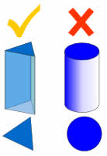
More Facts about Prisms
A prism is a solid object with identical ends
Prisms are polyhedrons which means that all of their faces are flat – They have No Curves!
Each end of a prism is called a base
E.G – A cylinder is not a prism because it has curved sides

Slide 4
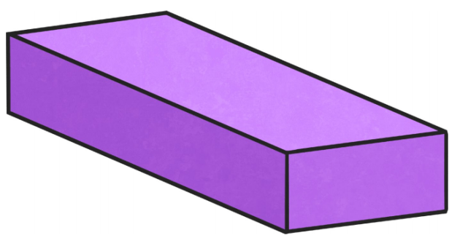
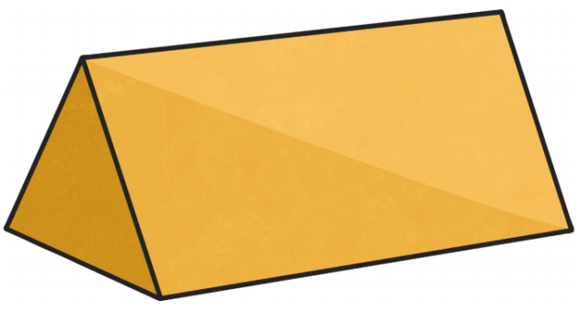
Examples of Regular Prisms
Rectangular prisms have:
• 6 faces • 12 edges • 8 vertices • edges that are not all the same length
Triangular prisms have:
• 5 faces • 2 triangular faces • 3 rectangular faces

Slide 5
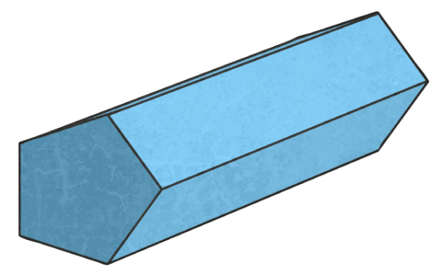
Pentagonal prisms have:
• 7 faces • 2 pentagonal faces • 5 rectangular faces • 15 edges • 10 vertices

Slide 6
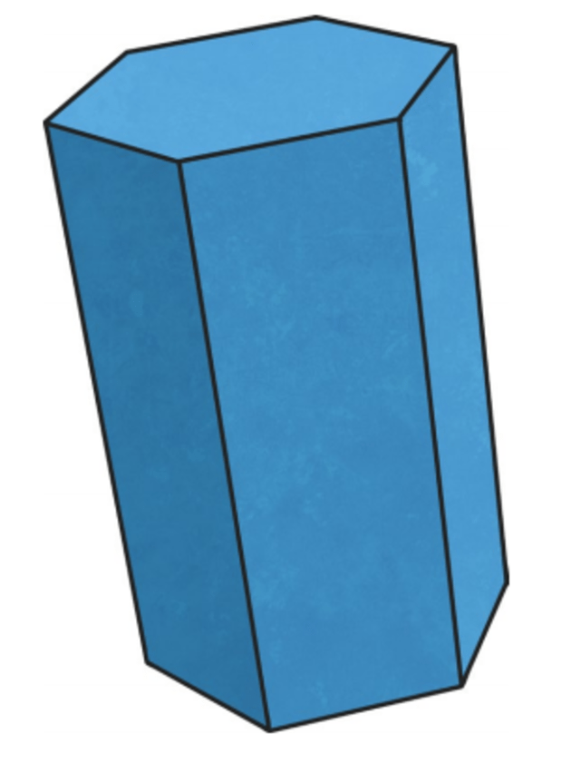
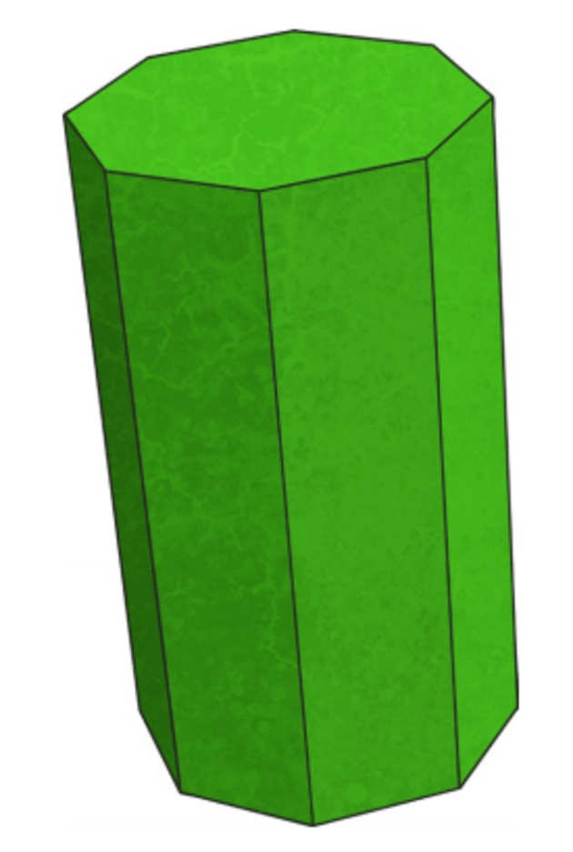
More Examples of Regular Prisms
Octagonal prisms have:
• 10 faces • 2 octagonal faces • 8 rectangular faces • 24 edges • 16 vertices
Hexagonal prisms have:
• 8 faces • 2 hexagonal faces • 6 rectangular faces • 18 edges • 12 vertices

Slide 7
Do these activities into your copies!

