Slide 1
5th Class Directed Numbers
My Goal is
to see that there are numbers less than zero and use them

Slide 2
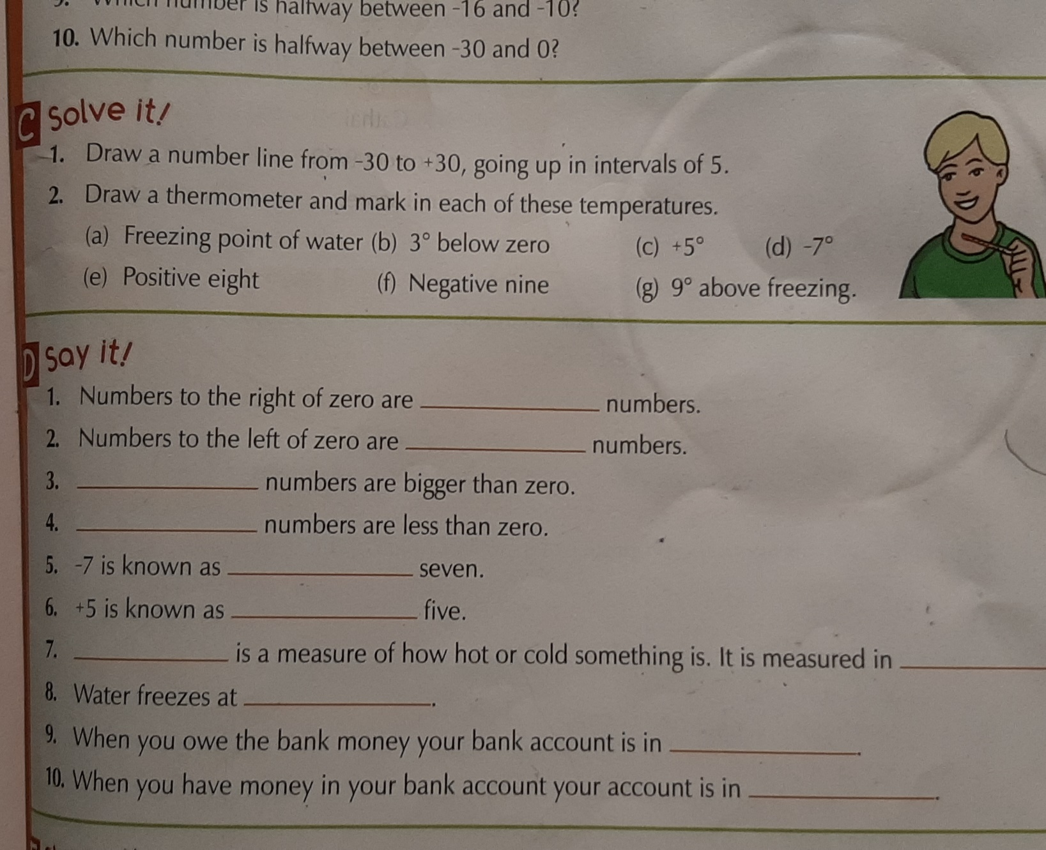
Let’s Revise Friday

Slide 3
Happy Friday Girls!
Well Done!
There is nothing negative about us
WE Rock

