Slide 1
Length
My goal : To Estimate and Measure Length and Perimeter

Slide 2
Revision
Do exercise into copy.. I’ve done no. 1:
1. 2mm = 0.2cm

Slide 3
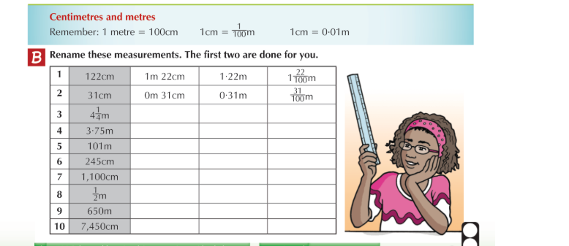
Revision
Draw renaming chart into copy and complete

