Slide 1
5th Class Maths
Topic: Weight
Goal: To estimate weight and carry out weight operations

Slide 2
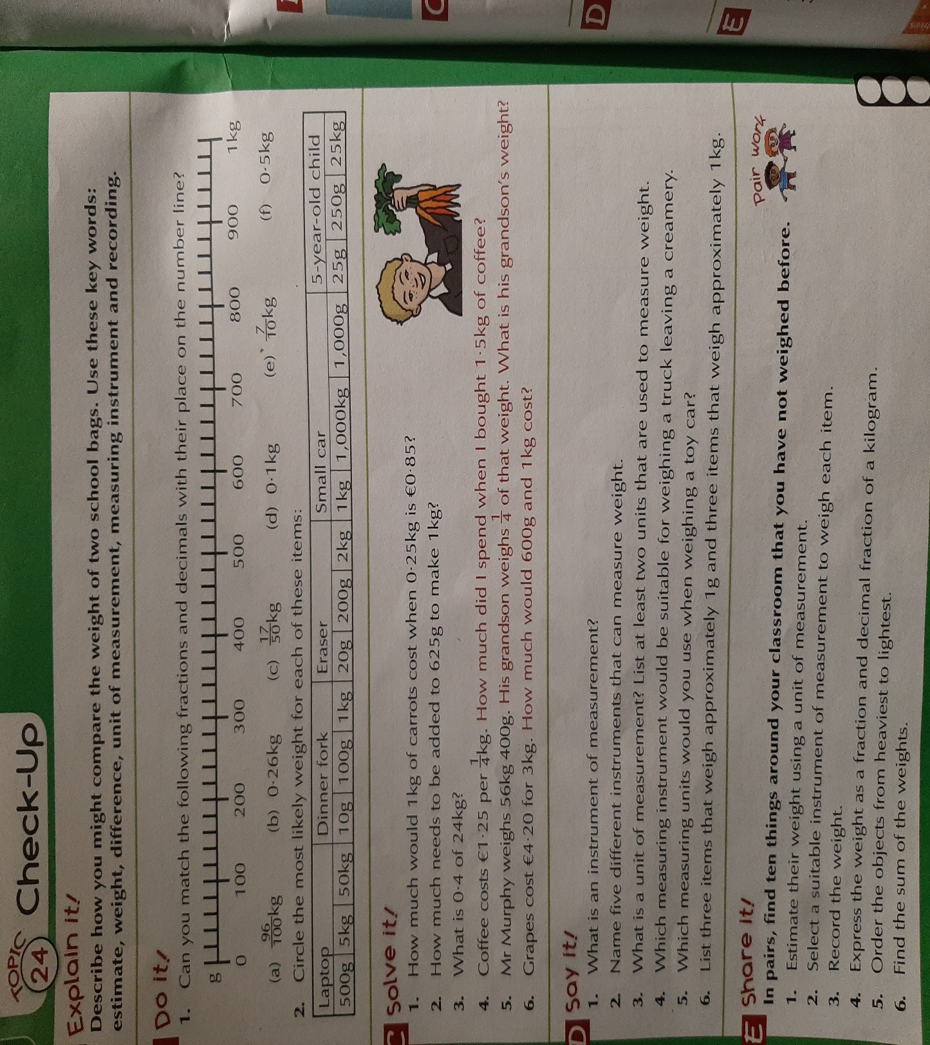
Do It
1 Draw the number line in your copy and match the fractions/decimals with their place on the number line
Solve It
Work out the answers to Questions 1 – 6 in your copy
Say It
Answer the questions in this section orally

