Slide 1
6th Class Maths
Topic: Weight
Goal: To estimate weight and carry out weight operations

Slide 2
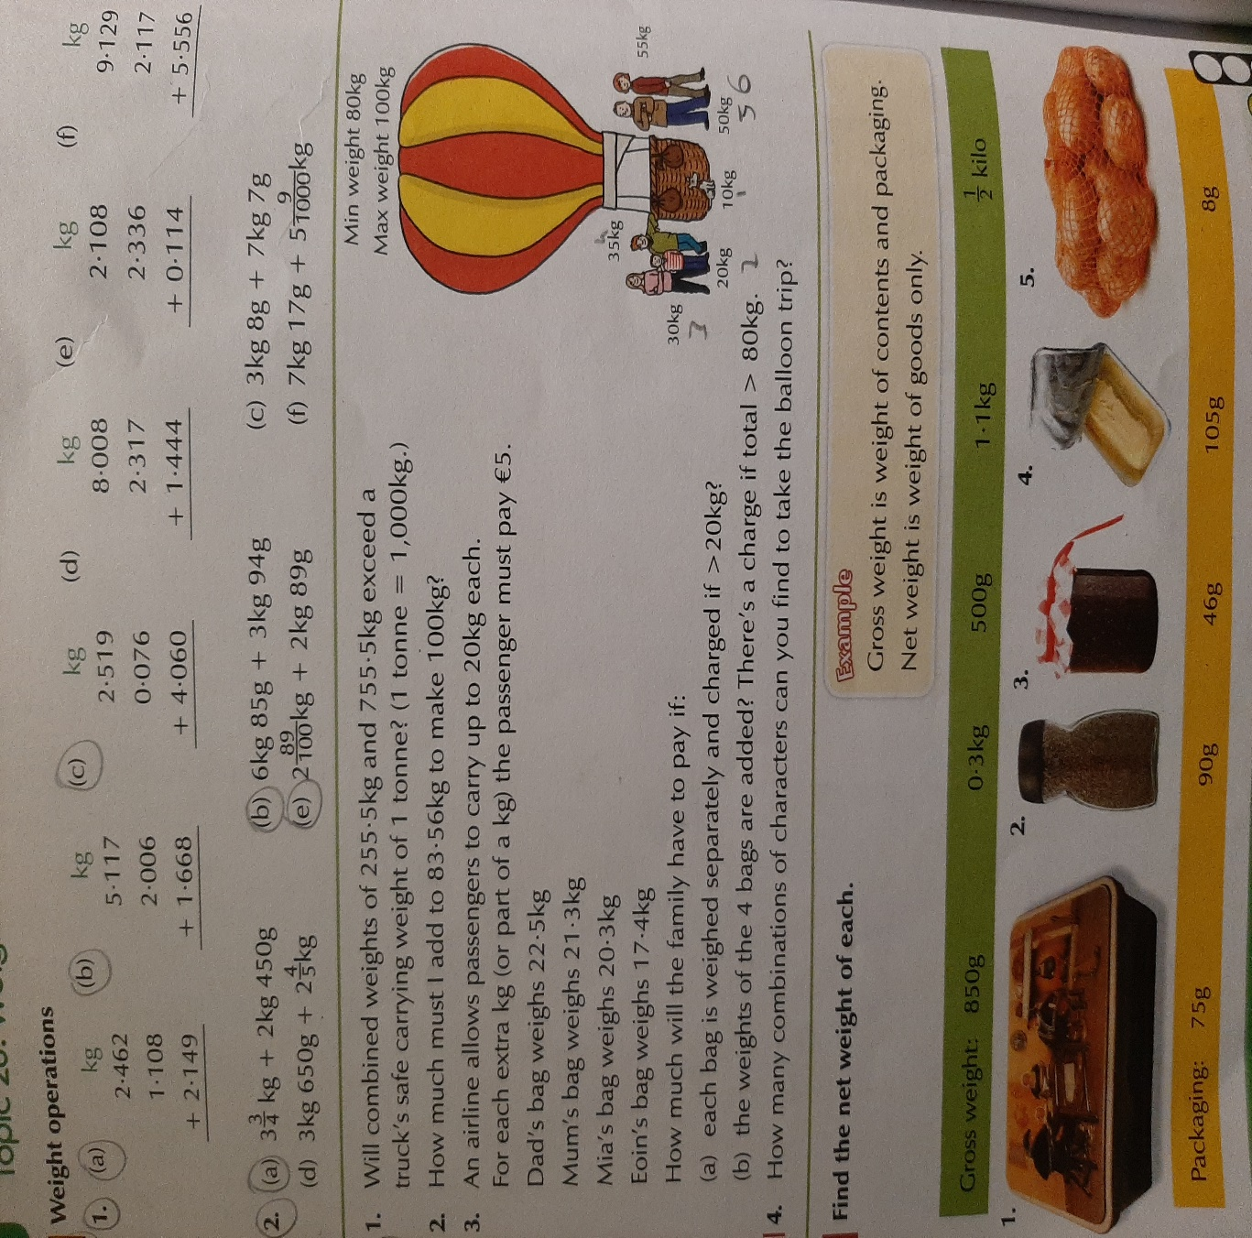
Tuesday
Do A ( 1 & 2)
&
B (1,2,3 & 4)

