Slide 1
6th Class Maths
Topic: Weight
Goal: To estimate weight and carry out weight operations

Slide 2
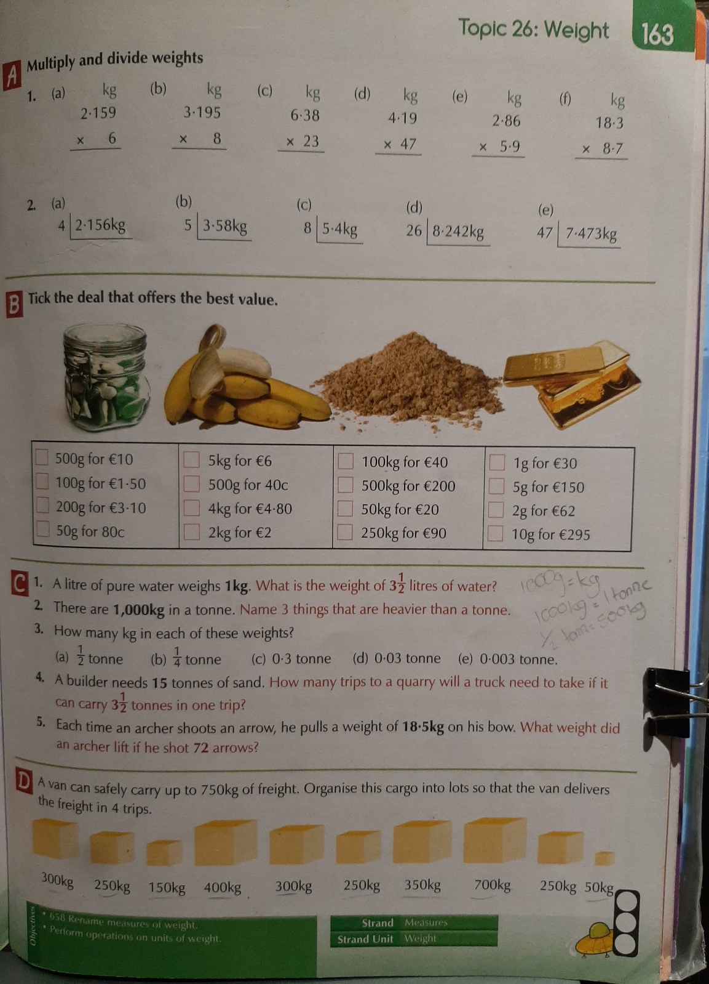
Do A, B & C into your copy

