Slide 1
Trippy Shape
What is a Mobius Strip?

Slide 2
So, What is a Mobius strip?
The Möbius strip, also called the twisted cylinder, is a one-sided surface with no boundaries.
It looks like an infinite loop

Slide 3
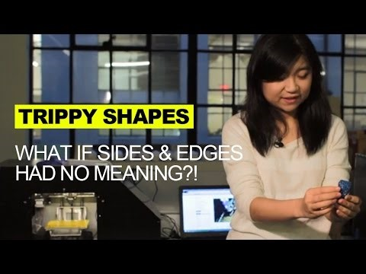
Have a look at this video and look up other information online about Mobius Strip if you need more information!
To play the video, click on middle of video. Wait for it to load and press play!

Slide 4
Follow the instructions to make your own Mobius Strip!

