Slide 1
Capacity
My Goal: To Estimate and Measure Capacity

Slide 2
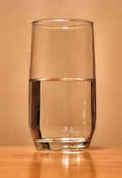
Capacity Definition:
Capacity refers to the amount of liquid a container can hold. Example: This glass has a capacity of 300 ml (but is actually holding only 160 ml)

Slide 3
Measuring Capacity and Reading Scales Video

Slide 4
‘Think’ Exercise

Slide 5
Today’s Activity

Slide 6
100 ml = 1/10l =0.1l
10ml= 1/100l =0.01l
1ml= 1/1000l =0.001l

Slide 7
Activity 1

Slide 8
Activity 2

