Slide 1
5th Class Maths Tuesday 28th April
Topic: Weight
Goal: To estimate weight and carry out weight operations

Slide 2
More Converting Draw & Complete the conversion table using grammes and kilogrammes Remember 1 kg = 1000 g
1 gramme | 1/1000kg | 0.001kg
2g | 2/1000kg | 0.002kg
3g
4g
5g
6g
7g
8g
10 grammes | 10/1000 kg | 0.01kg
20g | 20/1000kg | 0.02kg
30g
40g
50g
60g
70g
80g

Slide 3
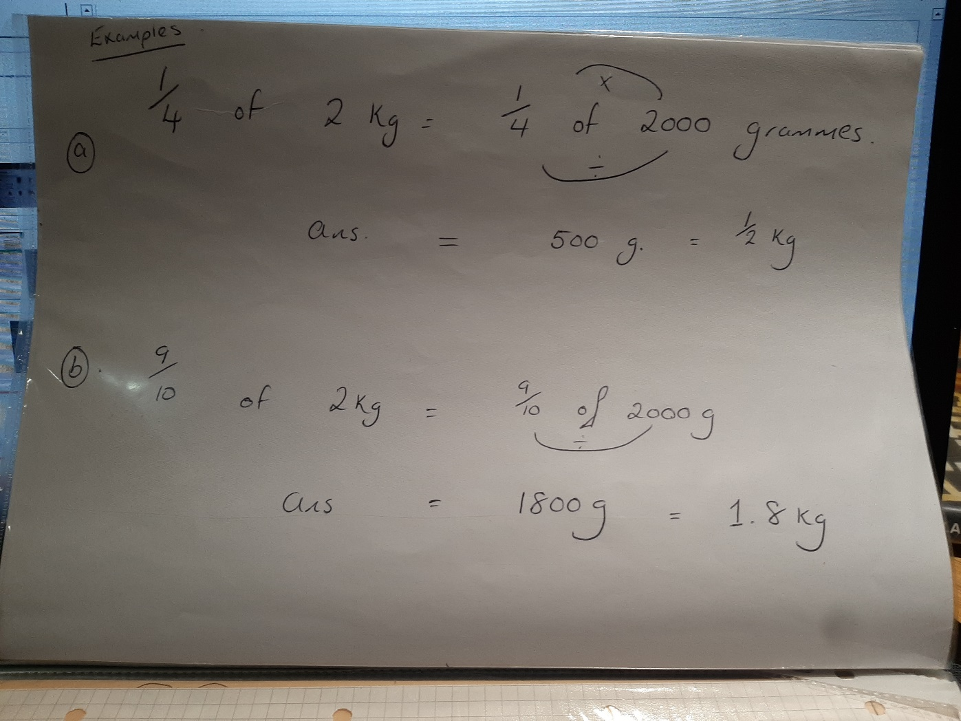
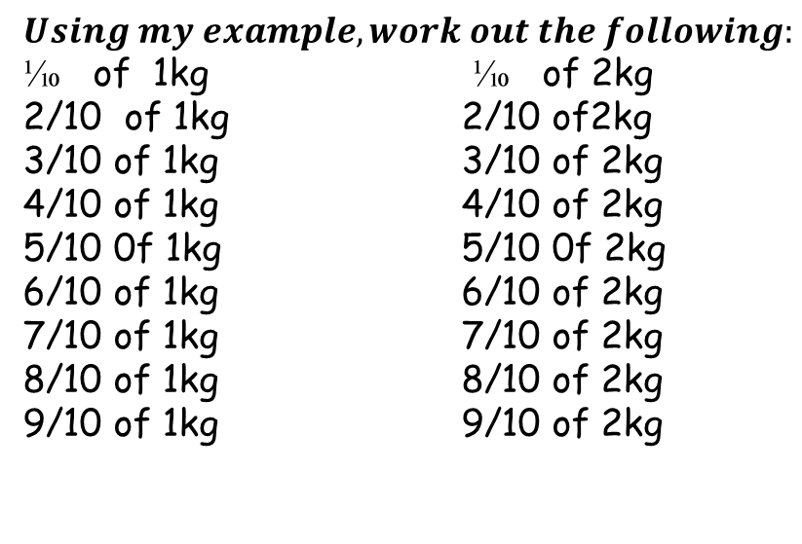
Fractions of ……
$Using my example, work out the following:$⅒ of 1kg ⅒ of 2kg
2/10 of 1kg 2/10 of2kg
3/10 of 1kg 3/10 of 2kg
4/10 of 1kg 4/10 of 2kg
5/10 0f 1kg 5/10 0f 2kg
6/10 of 1kg 6/10 of 2kg
7/10 of 1kg 7/10 of 2kg
8/10 of 1kg 8/10 of 2kg
9/10 of 1kg 9/10 of 2kg

Slide 4
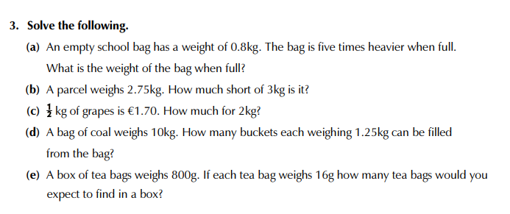
Extra Work (Challenge Yourself)

