Slide 1
UN Convention on the Rights of the Child

Slide 2
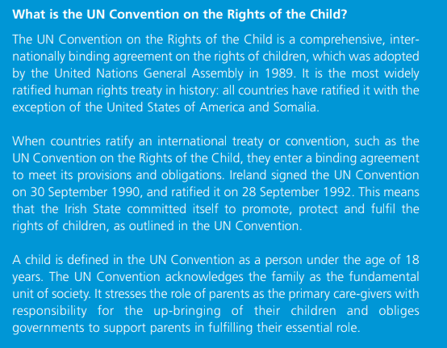

Slide 6
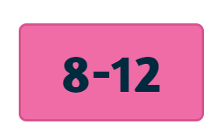

Slide 7
Go to www.itsyourright.ie
Write these out in your own words

Slide 8
Go to www.itsyourright.ie
Write our these children’s rights in your own words

Slide 9
Rights 9, 10, 11 & 12
Look up itsyourrights.ie, click on age 8 – 12 and find these 4. Click on each one and explain each right in your own words!

Slide 10
Rights 13, 14, 15 & 16
Look up itsyourrights.ie, click on age 8 – 12 and find these 4. Click on each one and explain each right in your own words!

